Slide 1
Florida Industrial Security Working Group (FISWG)
SF86 Review Workshop
Nannette Bell
December 2012

Slide 2
Agenda
Most Common Rejections
Tips and Trends
Rejection Agreement

Slide 3
The top 5 reasons an e-QIP is rejected:
Section 13 Employment History
Sponsoring company is not listed as the current employer
Section 17 Marital Status
Incomplete information for spouse or cohabitant – Must include Social Security Number, “other names used”, (i.e. maiden name) complete address and citizenship information
Section 18 Relatives
Incomplete information on family and associates – Must include complete address, citizenship information etc. If there is no contact with the relative or associate, that must be stated and explained in the comments
Section 26 Financial History
Incomplete information for financial history - Must include name and address of lender, account number and if satisfied or pending with detailed explanation
Additional Comments
Any comments throughout the form that suggest an entry should be added. Including any conflicting information

Slide 4
Helpful Hints What to “Accept” During Review of the SF86
Section 1 – Full Name
The name provided on the SF86 form should be the full legal name, not a nickname, abbreviation, etc. It should have more information than what is listed in JPAS.
Example:
SF86 – John Michael Smith - Acceptable
JPAS – John M Smith
SF86 – Jonny M Smith – Not acceptable if not legal name, it should match JPAS
JPAS – John Michael (M) Smith
Section 2 and Section 3 - Date of Birth and Place of Birth
The date and place of birth must match what is listed in JPAS and be present in the form
Section 11 – Where You Have Lived
Provides an incomplete address, but does not provide an explanation
Does not provide a verifier for their address with no explanation

Slide 5
Helpful Hints (cont.)
Section 14 - Selective Service Number
If the employee has been in the military, the selective service number is not required
Section 16 – People Who know you
Employee does not provide at least 1 entry
Section 17 – Marital Status (Other Names Used)
If the employee is a male and is married, the employee does not have to provide his spouses’ maiden name
Section 18 - Other Names Used
If employee does not provide their relative’s address, or other required info with or without an explanation
Section 20C – Foreign Travel
If employee includes foreign travel entries but does not provide US passport information

Slide 6
Resizing Releases Using Adobe Reader “JPAS Error: Document Size is invalid”

Slide 7
JPAS Error: Document Size is invalid
When uploading releases and you see this error…

Slide 8
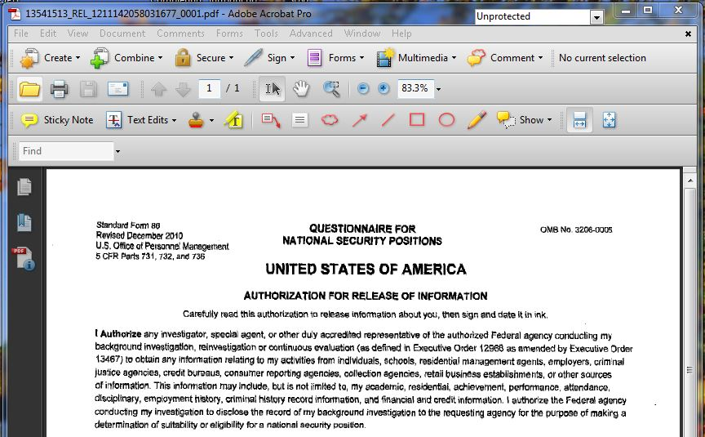
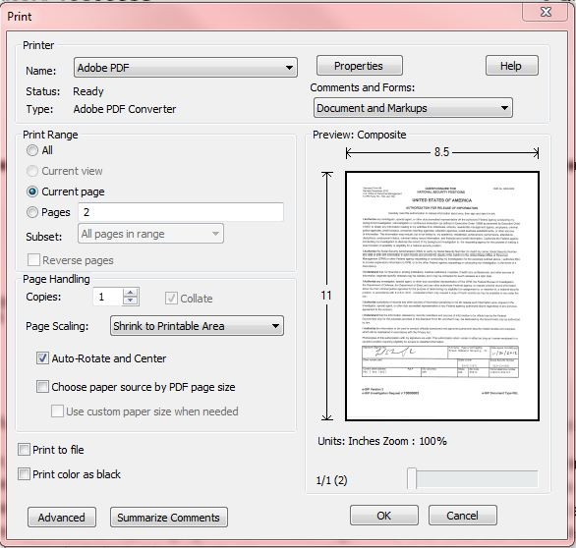
JPAS Error: Document Size is invalid
Open the release from your desktop that’s giving the error and click
File > Print

Slide 9
JPAS Error: Document Size is invalid
Print to “Adobe PDF,” then click Advanced

Slide 10
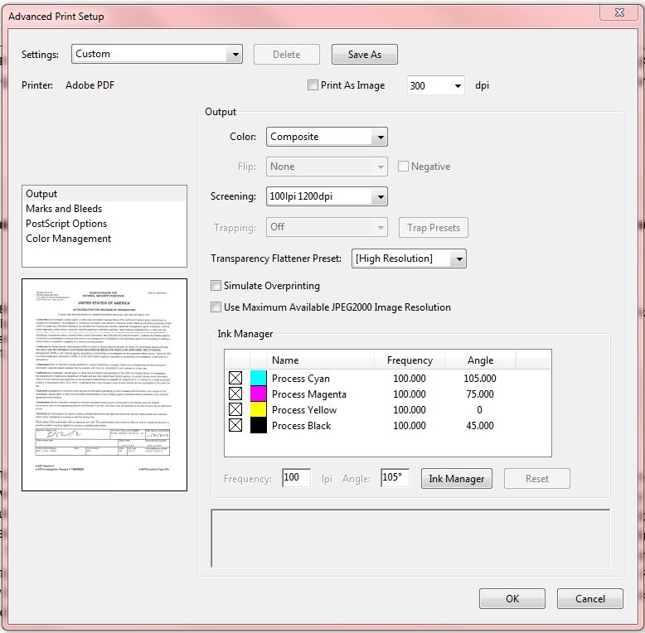
JPAS Error: Document Size is invalid
Change the Output Screening to the lowest “lpi/dpi” option, then click OK

Slide 11
JPAS Error: Document Size is invalid
Click OK

Slide 12
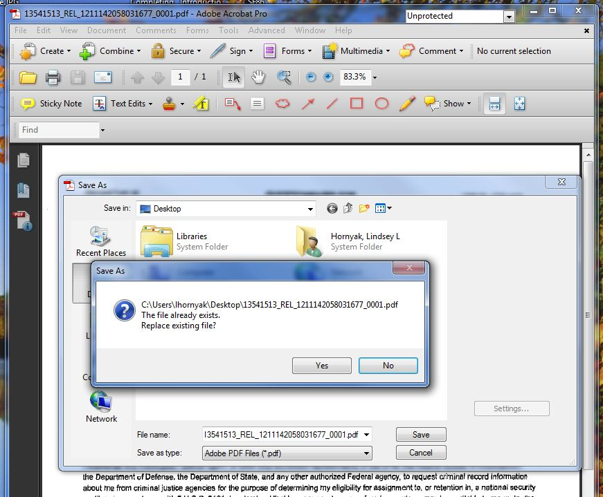
JPAS Error: Document Size is invalid
Save and replace the current release

Slide 13
JPAS Error: Document Size is invalid
Now upload the release into JPAS again
JPAS Screenshot Removed

Slide 14
JPAS Error: Document Size is invalid
Upload Received
JPAS Screenshot Removed

Slide 15
Questions??

Slide 17
Florida Industrial Security Working Group (FISWIG)
E-Fingerprints
Nannette Bell
December 2012

Slide 18
E-Fingerprints
By memorandum dated July 29, 2010, the Under Secretary of Defense for Intelligence issued a requirement for Department of Defense (DoD) components to transition to electronic capture and submission of fingerprint images in support of all background investigations by December 31, 2013.
DSS Website
Electronic Fingerprint Capture Options for Industry
FBI Product List
IAFIS Certified Product List
SWFT Information
Frequently Asked Questions
AskDISCO Webinar slides

Slide 19
E-Fingerprints - Options
Implementation Options
Purchase your own equipment/fingerprint capture devices
Cross Match Technologies, Inc. , Guardian
Software is available that is compatible with Windows 7
Companies Sharing Resources
LMCO processes our Contractors (i.e. guard services, admin services)
Company(s) Offering Service
May assist smaller companies
Submits the file via SWFT
Third Party Vendor Provides Electronic File
Collects the prints, saves them in required format and provides the file to the company. The FSO of the company uploads the file to SWFT
DoD Agency Support

Slide 20
E-Fingerprints – Helpful Hints
TCN Numbers
A TCN number is generated for each fingerprint that contains your cage code
This number is used to identify the fingerprint and where it came from. It is beneficial to keep this number, and associate it with the employee, in the event the fingerprint needs to be resubmitted
You may submit fingerprints for others, such as your contractors, even if they are not attached to your cage code in JPAS. The fingerprints will reach their destination and the status will show up in the individuals JPAS record

Slide 21
E-Fingerprints – Helpful Hints
SWFT – Registration, Access and Testing Procedures
Access Request
Company Vetting Form – Electronic submission
SAR Form for access to SWFT – Electronic submission
The minimum background investigation for a SWFT user is a NACLC and interim secret eligibility
Registration of equipment
Registration of Equipment
Equipment must be registered prior to use

Slide 22
E-Fingerprints – Helpful Hints
Information on the e-Fingerprints
Only rolled fingerprints are accepted
When initiating an employee in e-QIP via JPAS you must select “I” in the FIPC field. This triggers a mechanism that delivers necessary e-QIP data to SWFT where they can be matched with the same type of data obtained from the e-Fingerprint file
Fingerprints must be submitted to OPM within 14 days of the e-QIP being submitted to the government
Fingerprint files are only good for 120 days
After the e-Fingerprint (EFT) is released to OPM it is automatically deleted from the SWFT database.
If the e-QIP is marked “Unacceptable” by OPM and must be resubmitted, you must also resubmit the fingerprint

Slide 23
Questions??

